Slide 1


CS641
FITCHECK
HTTPS://GITHUB.COM/SUNDAESTROLL/FITCHECK/WIKI
PRESENTATION BY SEUNGAH CHOI

Slide 2




ABOUT FITCHECK
A web application that is developed in PHP and MySQL Server
It is a web app where users can upload photos of their clothing items to build a virtual closet system
Users get to sign in or sign up to save their closet to their account
PAGE 02

Slide 3

WHAT WAS ACOOMPLISHED?
created a docker file and a YML file to build compose containers of the project
MySQL and a PHP server
Using the SQL dump file that is exported from the XAMPP myphpadmin to create the database once the MySQL container is built
Created an AWS account with the repo (credentials)
Deploy the container and the repo from GitHub to the AWS ECS system
Setting repository secrets to better the security of my secret keys from GitHub
PAGE 03

Slide 4
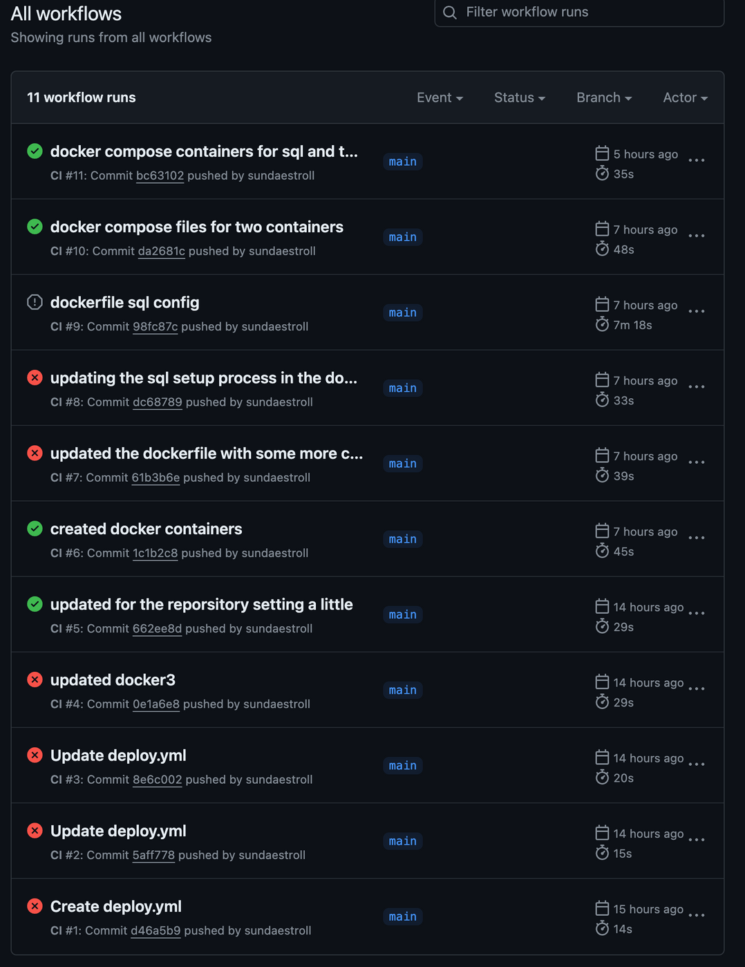
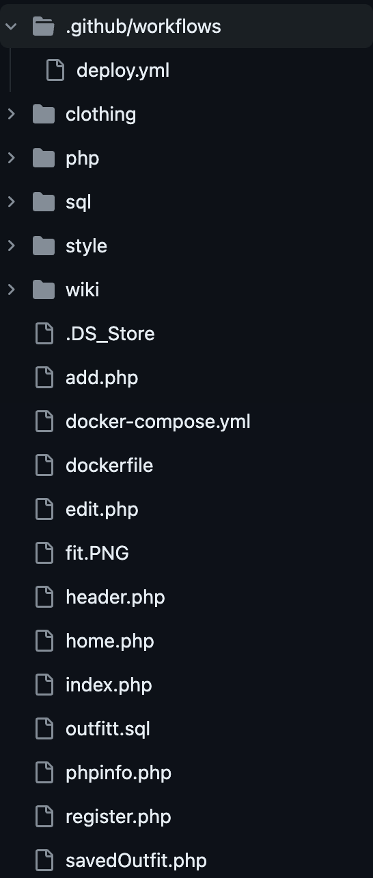

DEPLOYMENT FILES
PAGE 04
HTTPS://GITHUB.COM/SUNDAESTROLL/FITCHECK/WIKI

Slide 5
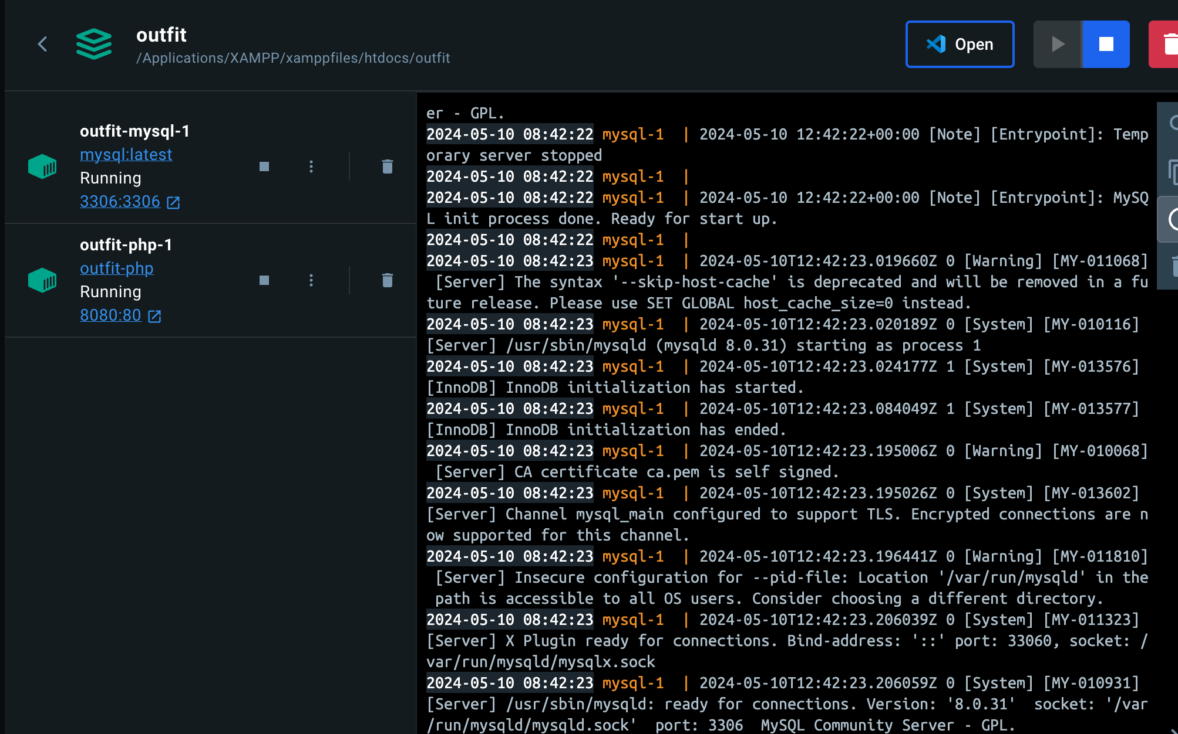

Slide 6
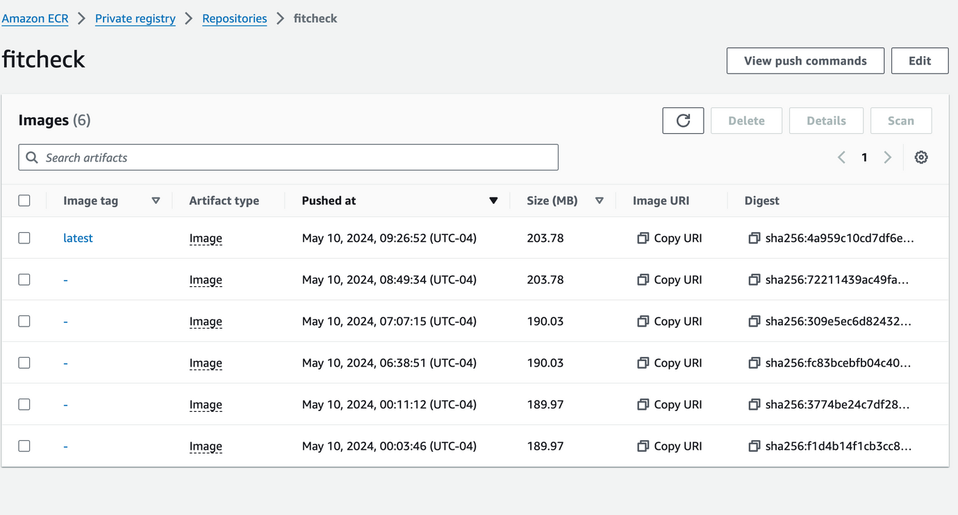
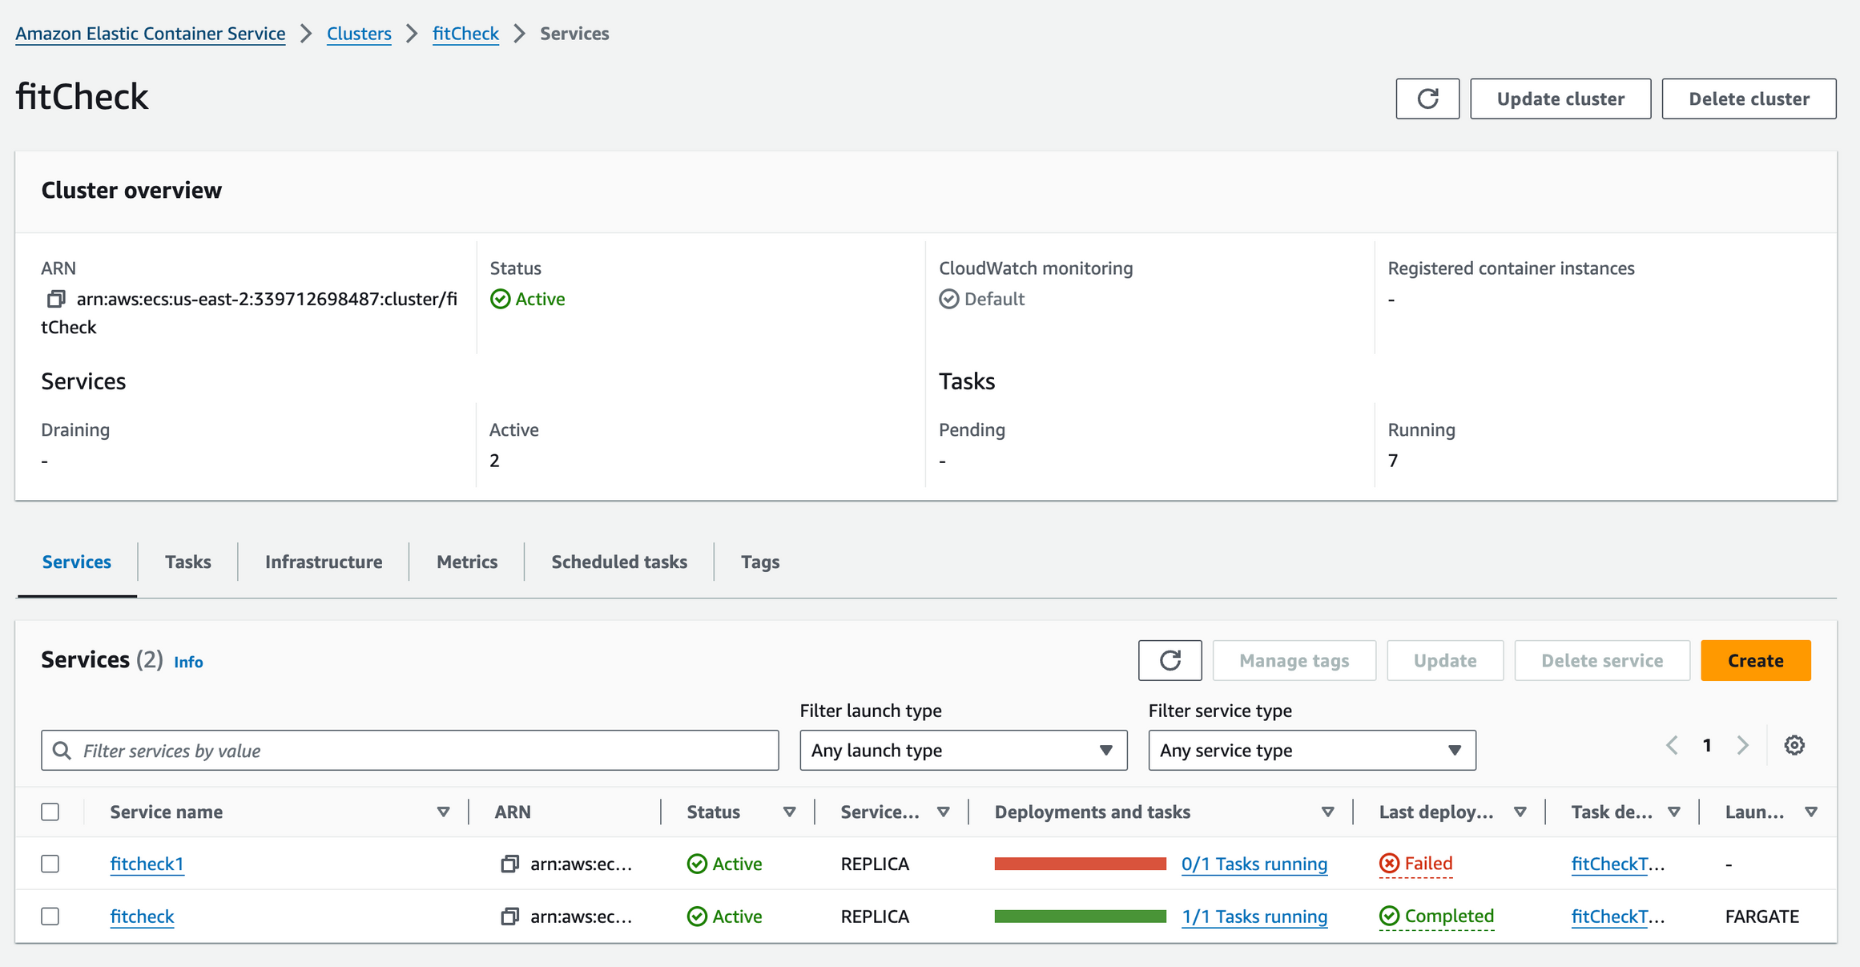
AWS ELASTIC CONTAINER SERVICE
PAGE 06

Slide 7
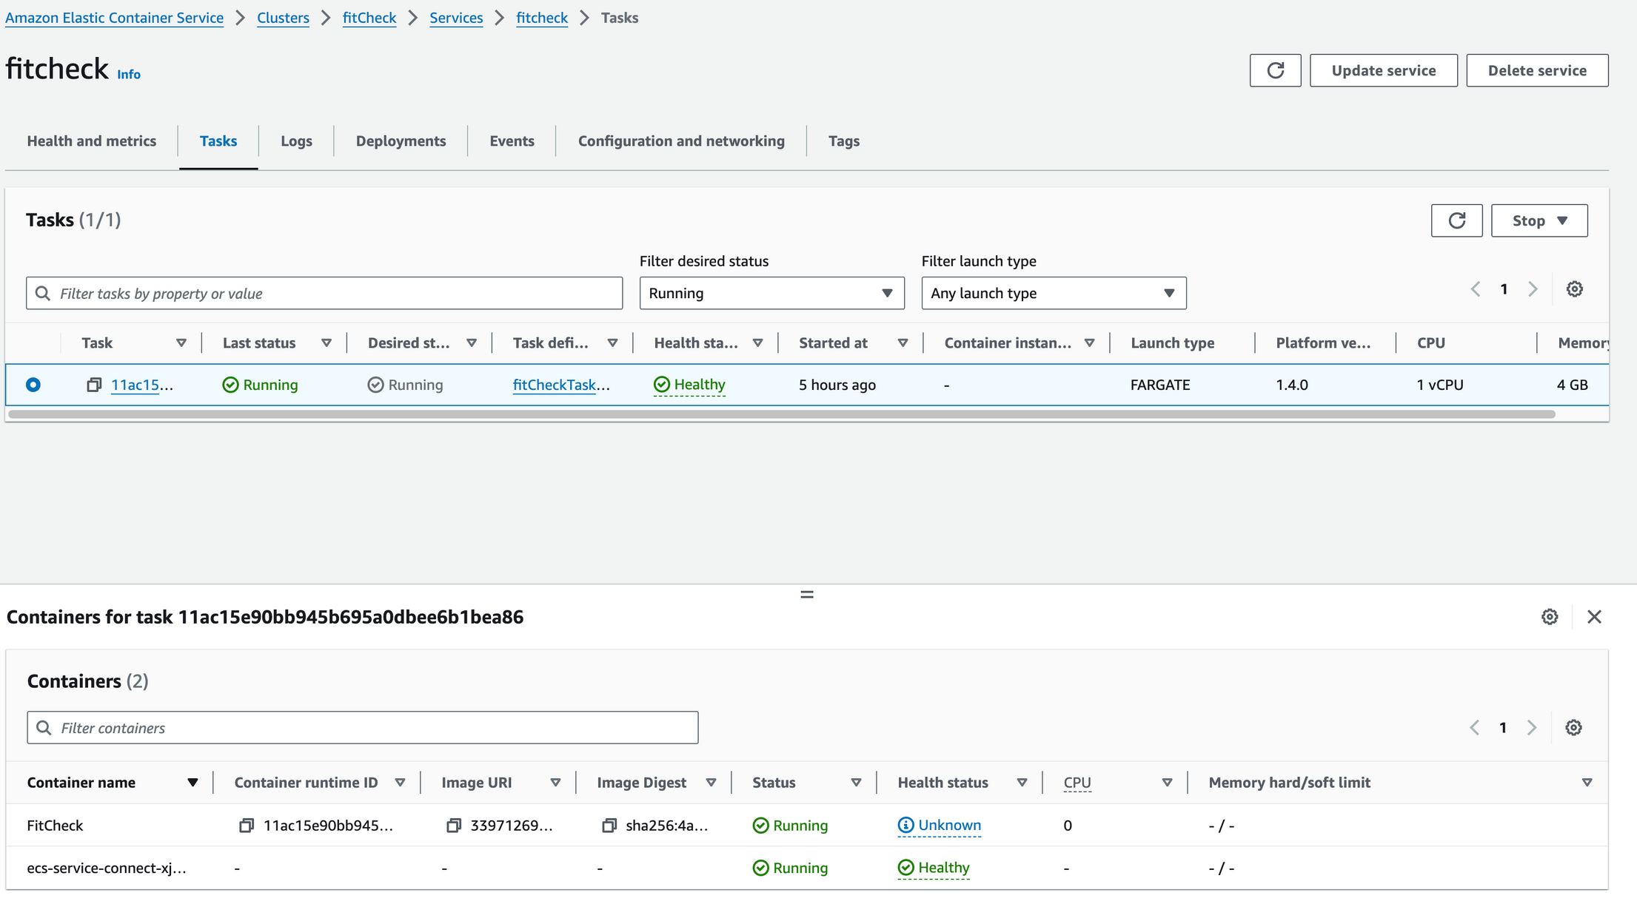

Slide 8

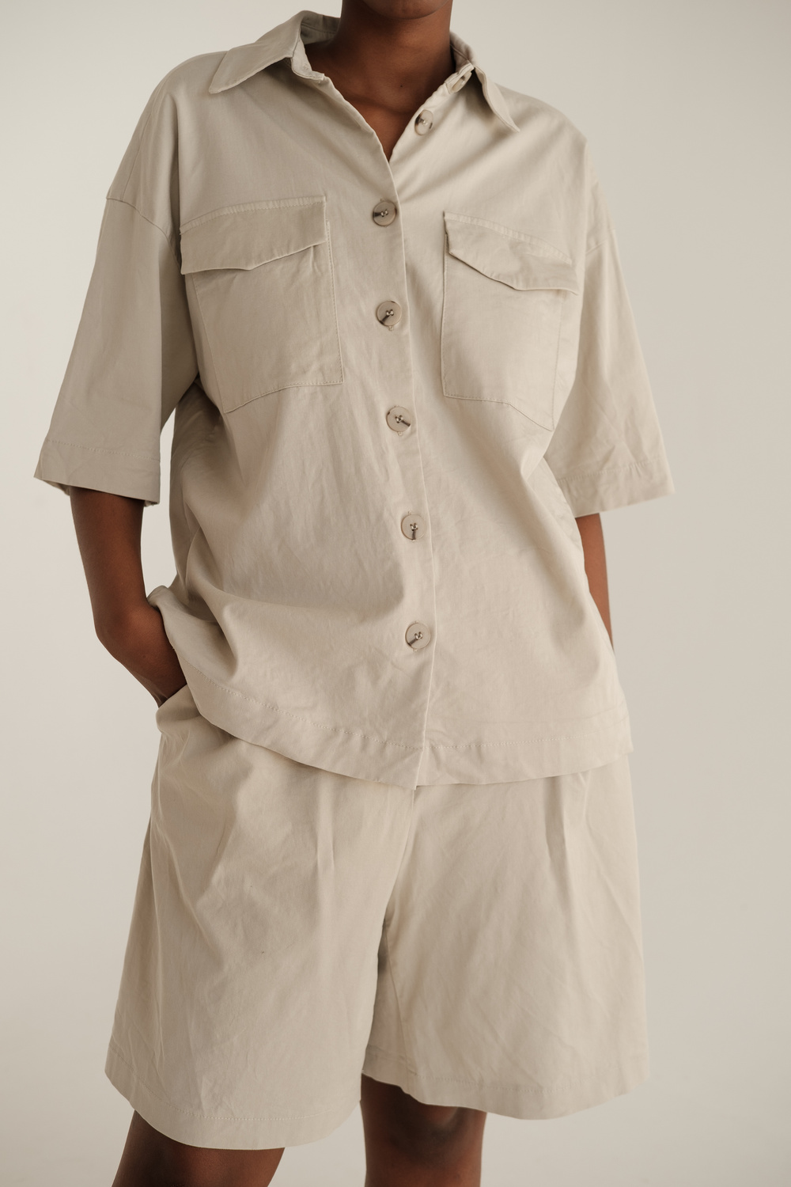

WHAT NEEDS TO BE DONE
Updating the AWS ECR settings to make the website visible to the public
PAGE 08

Slide 9

VISIT MY GITHUB
https://github.com/sundaestroll/fitCheck/wiki
PAGE 09

Slide 10



THANK YOU!
seungah0303@gmail.com
https://github.com/sundaestroll/fitCheck/wiki
PAGE 10

